Slide 1
Introduction to Java
Week 1

Slide 2
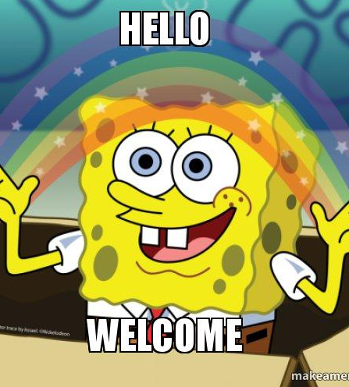
Ice breaker
Welcome to your first week of Introduction to Java!
Ice breaker: What’s your favorite flavor of ice cream?

Slide 3

Why learn programming?
One of the fastest growing industries
Computers are everywhere around us
Application of science and math
You get to make cool things

Slide 4
A bit about me
Sophomore
4 years of experience teaching/TAing for coding classes.
AIME qualifier
Robotics
Mock trial
Running and soccer

Slide 5
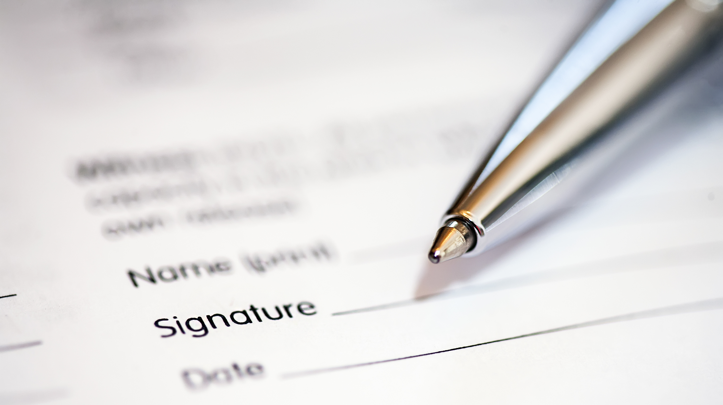
Course syllabus
Week 1 – introduction to the language/course, setting up, first piece of code
Week 2 - Data types, syntax
Week 3 – logic, expressions
Week 4 – loops, scope
Week 5 – more logic and loops
Week 6 – functions
Week 7 – classes
Week 8 - data structures
There will be a bit of homework each week, about an hour or less.

Slide 6
Classroom expectations
Homework is heavily suggested
Optional quiz in beginning of each class (helps you check your own retention)
If there is a question, put it in chat. Don’t be afraid to ask lots of questions!
Try to keep the chat on topic
Do the exercises as we go
Go easy on yourself, computer science isn’t easy!

Slide 7

What is JAVA?

Slide 8
JAVA
Developed in 1995 by Sun Microsystems
One of the most popular/commonly used languages in the world
Modern, continually updated by Oracle
Easily used across multiple platforms, wide range of applications
Object orientated
Often used for programs on the internet
Relatively simple

Slide 9
Setting up your computer
Install the Java JDK and an editor
Recommendations: jGRASP, Visual Studio Code
For this class: VSCode
Make a folder on your computer for this class

Slide 10
What is a program?
A sequential list of instructions for the computer
ORDER MATTERS!!
What does it take to be a good programmer?

Slide 11
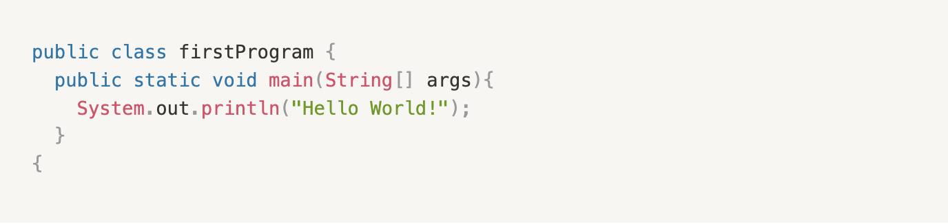
First java program
For our first day, we’ll use Jdoodle (https://www.jdoodle.com/online-java-compiler/).
The name of your public class needs to match the file name
Copy this down accurately, capitalization does matter
You just finished your first Java program!
You set up a main function and printed something!
Notes:
Main function is just what Java looks for when you run the program, it is what performs the actions.
Anfy java file is .java.

Slide 12

How did that work?
Write the code
Compile it
The code is converted into byte code, in a .class file
Run it
Notes:
Java has a runtime environment, which runs the bye code, .class

Slide 13
Structure
Lets take a look at the different parts of a program – class, method, statements

Slide 14
the statement
The instructions your computer receives
For our last program: print statement

Slide 15
Naming your classes
There was something wrong with our earlier class’ name
When naming, use one word, be descriptive, not too long.

Slide 16
exercises
Are these proper names for classes or variables?
1. bigCat3
2. SmallCat
3. _lazyCatName
4. 44CatsInARoomTogetherWithoutToys
5. $CatWithALotOfMoneyInTheWallet

Slide 17
Avoid using ”keywords”
Don’t name things with keywords, that isn’t legal.
List of all java keywords: https://docs.oracle.com/javase/tutorial/java/nutsandbolts/_keywords.html
Also stay away from names that sound similar to keywords
Formally, names of classes, variables, and methods are called identifiers

Slide 18
Bugs
Syntax errors – wrong spelling, forgotten punctuation
Runtime errors – things that happen while program is running
Logic errors – code runs fine, but doesn’t do what you want it to

Slide 19
Check for bugs
Trace
Trace the error message to the line of code where it originated
Look
Look for spelling errors
Run through
Run through the code, simulating what happens, and how it differs from what is actually happening (logic error).

